Slide 1
Senior Seminar
CS 4900 Group 2
PropHop
Week 6
Wallace Coleman
Allen Kubinski Jenna Schott

Slide 2
Broke Jumping
jumpCaster keeping old far value
Notes:
So we ran into an issue with our jumping. To refresh on how we implemented jumping, we have a raycaster that follows the player object, and if it detects an object beneath the player you can jump.
This raycaster changes its far value based on the parameters of the object you change into in order to adjust jumping for different objects. We discovered that when you were playing as a smaller object, and left the level, when you loaded back in you could no longer jump.
The cause of this issue was that the raycaster was keeping the far distance from the small object and you it could not

Slide 3
Change in Level
To Menu then back to Level
Notes:
So, you start off a big object when you become small the jumpCaster gets shorter, if you returned to the menu the jumpCaster is not changed. When you return the the level, because you haven’t switched objects in the level the jumpCaster remained unchanged.
We fixed this by updating the jumpCaster whenever you change levels.

Slide 4
Jumping with Spheres
jumpCaster was trying to set its far value based on height, however spheres do not have height
Notes:
The way we set the far value was checked to see if an object was rotated on its side and if it was we checked if the radius of the 3d object exists.
If it does we set the jumpcaster based on the radius. This is how we handled the log. If it would have been oriented differently we would have wanted the jumpCaster to be based on height.
The sphere however always needs to be based on radius regardless of orientation, so the code we had couldn’t handle it.
After updating, we can now jump with spheres

Slide 5
Main Menu
Start Game
Level Select
Notes:
We worked on our main menu, and now Start launches the game, and the level select takes you to a menu that levels you select from the available levels, and we’ll demo our menu at the end.

Slide 6
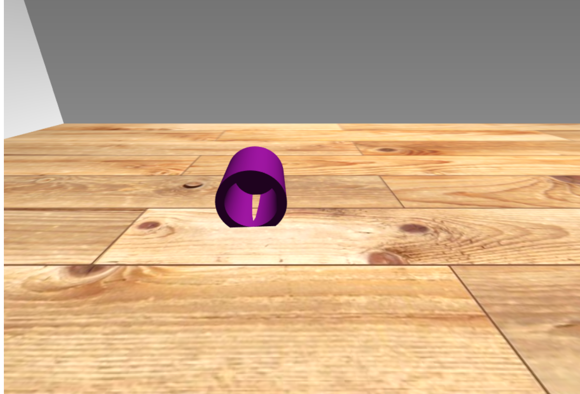
Notes:
Many of our level concepts used the idea of putting objects into, or hiding objects under. However, we aren’t sure if that was possible. Here is a simple cylinder model that was created in blender and imported into our map.
When we imported this model, our physics engine could see it, but it wouldn’t interact with it properly.

Slide 7
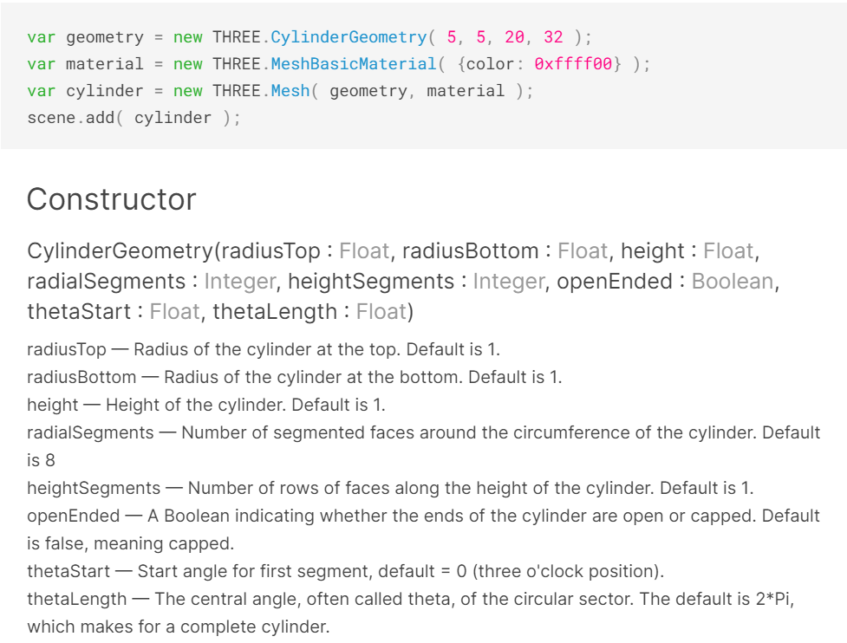
Notes:
When creating a simple Geometric cylinder, I discovered recently that there are already constraints in place that allow you to use an open-ended cylinder.
I was really excited with this solution because MeshBasicMaterial was compatible with Physics, so I was hoping that our physics engine would see the open ended cylinder and automatically know that smaller objects would be able to go inside an open-ended cylinder.
This wasn’t exactly the case though (next slide)

Slide 8
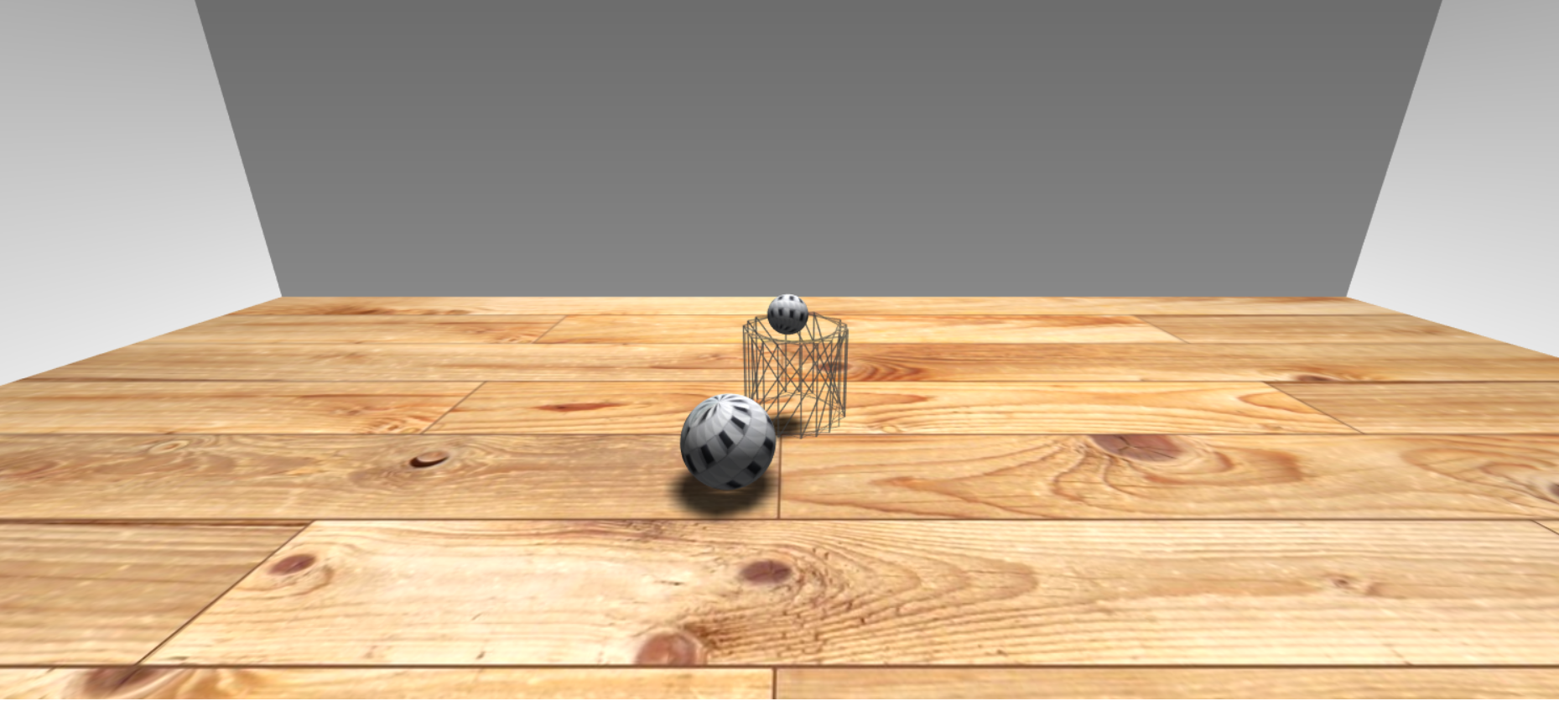
Notes:
Testing it was a different story. Here you see an example of an open-ended cylinder mesh when I was testing it. The smaller sphere was unable to recognize that this was an open ended object (and I tested both sides in case you were wondering). After testing this out, I found out that this is an ongoing issue with using physijs, as theoretically, because of the geometric type and mesh, it should work, but it doesn’t.
As of right now, we don’t have a good solution for putting

Slide 9
Custom Mesh for a Lamp
function ( gltf ) {
let lampmodel = gltf.scene;
let lampbase = new Physijs.CylinderMesh(new THREE.CylinderGeometry(4,4,1,12),new THREE.MeshLambertMaterial({ wireframe: true, transparent: true, opacity: 0.5 }));
let lamppole = new Physijs.CylinderMesh(new THREE.CylinderGeometry(0.5,0.5,25,12),new THREE.MeshLambertMaterial({ wireframe: true, transparent: true, opacity: 0.5 }));
let lampshade = new Physijs.CylinderMesh(new THREE.CylinderGeometry(5,5,8.5,12),new THREE.MeshLambertMaterial({ wireframe: true, transparent: true, opacity: 0.0 }));
lampbase.add(lamppole);
lampbase.castShadow = true;
lamppole.castShadow = true;
lamppole.position.y += 18;
lampbase.add(lampshade);
lampshade.castShadow = true;
lampshade.position.y += 25;
lampbase.position.y = -20;
lampbase.position.x = 0;
lampbase.position.z = -10;
lampmodel.name = "player:slide";
lampbase.add(lampmodel);
lampbase.position.y += 1;
lampmodel.scale.set(5,5,5);
scene.add(lampbase);
Notes:
This is code in a very similar way as the ramp code that we had in a previous demo. Thank you Wallace.
We basically have to use simple geometric shapes and tell physijs the parameters for each object.
In this example, I had to create a cylinder for each part of the lamp.
WE TRIED TO MAKE THIS CODE EASY FOR YOU TO READ.
We have three different cylinders that uses the mesh and geometry with a specific size for each.
After we create each cylinder, we attach it to the parent, which is in this case the base.
We chose to have the base as the parent because that is where the origin is for the particular object, so it’s easier to know where it is in the scene.
From there, the children are proportional to where the parent is located, so we add each piece to the lamp base, including our model from blender 3d model.
In this example, we created the lamp so that it is harder to tip over, and we were able to do that by attaching the lampshade directly to the lampbase even though it’s not physically attached.

Slide 10
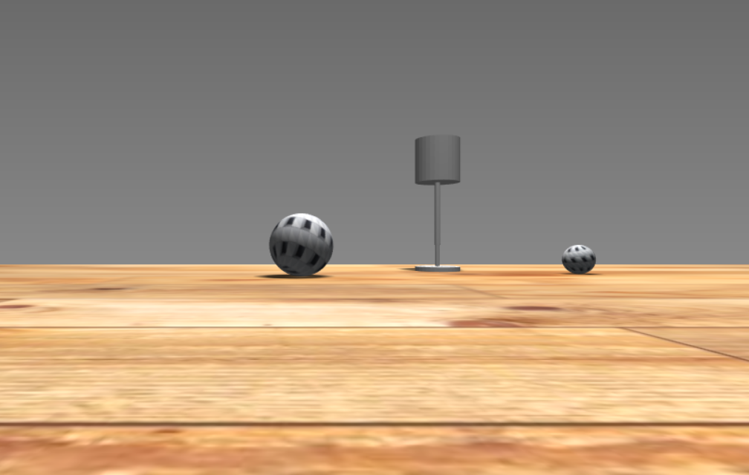
Notes:
Here’s an example of the lamp. In our demo, we don’t have the updated lamp. I was trying to get the light to cast in the right spot but I haven’t gotten that far yet. So, for next week, hopefully our lamp is working properly.

Slide 11
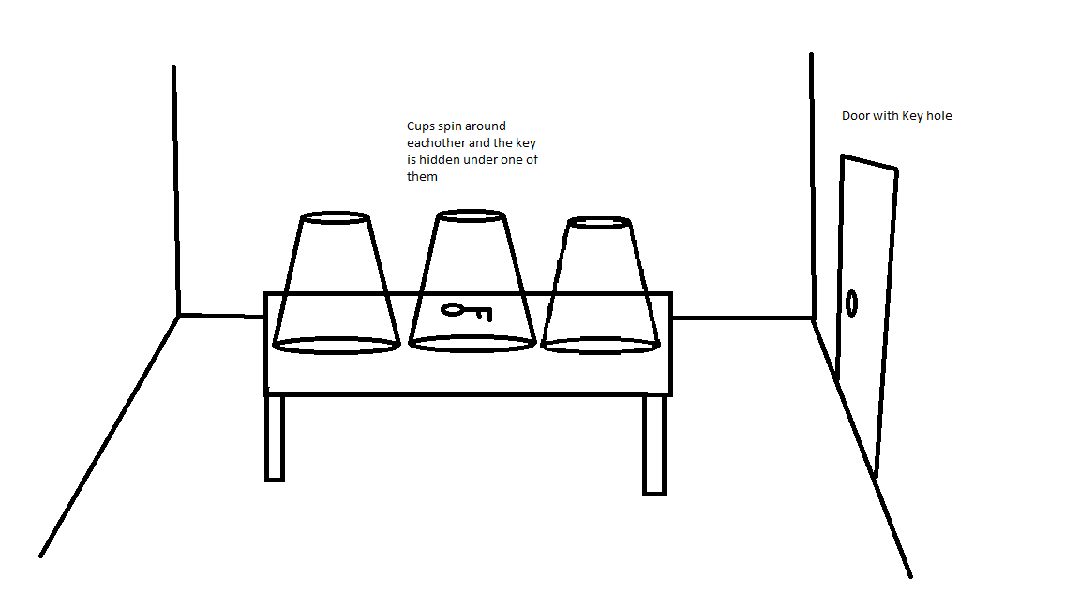
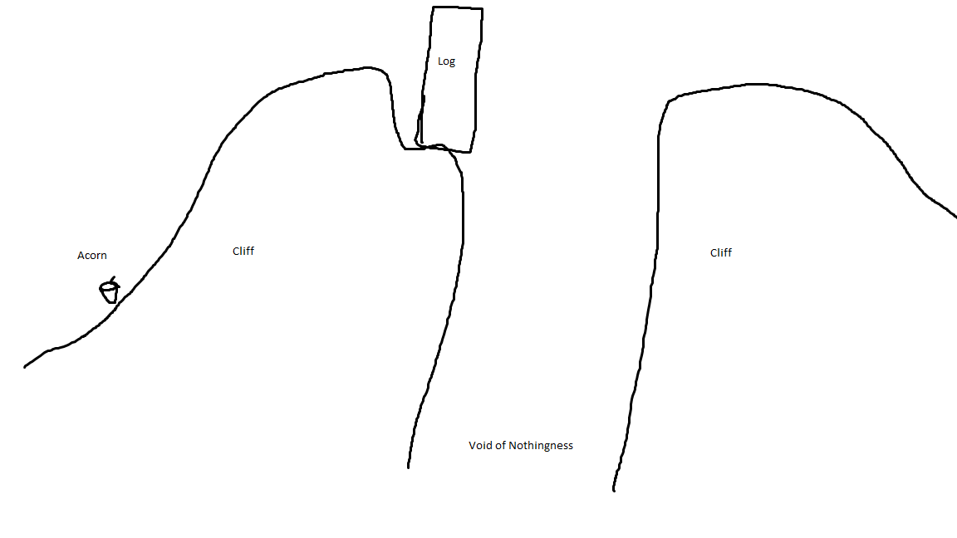
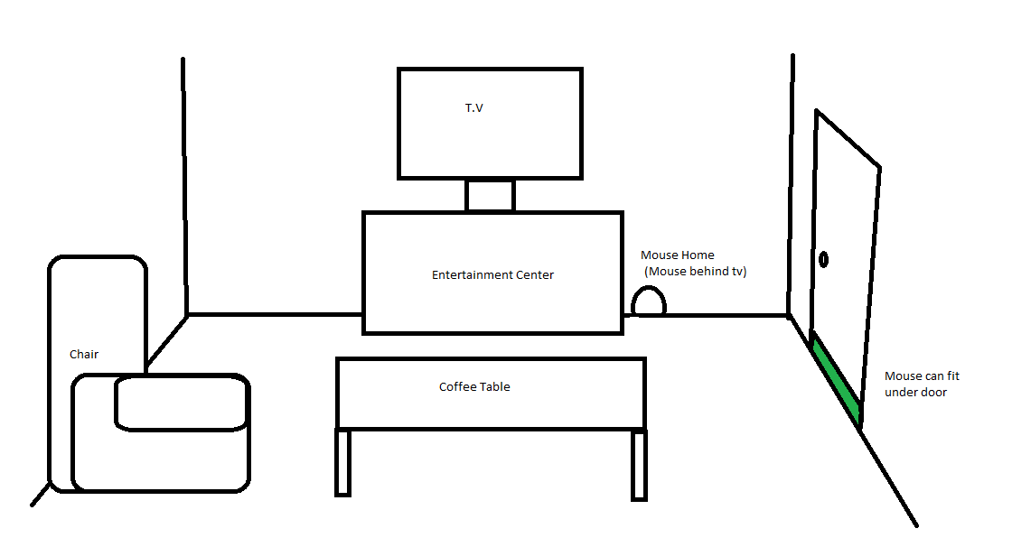
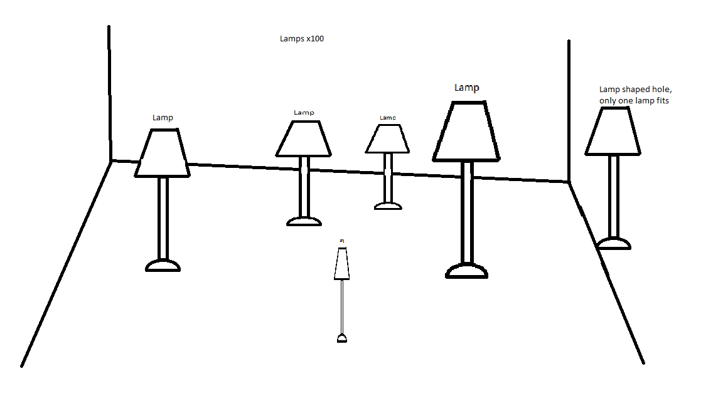
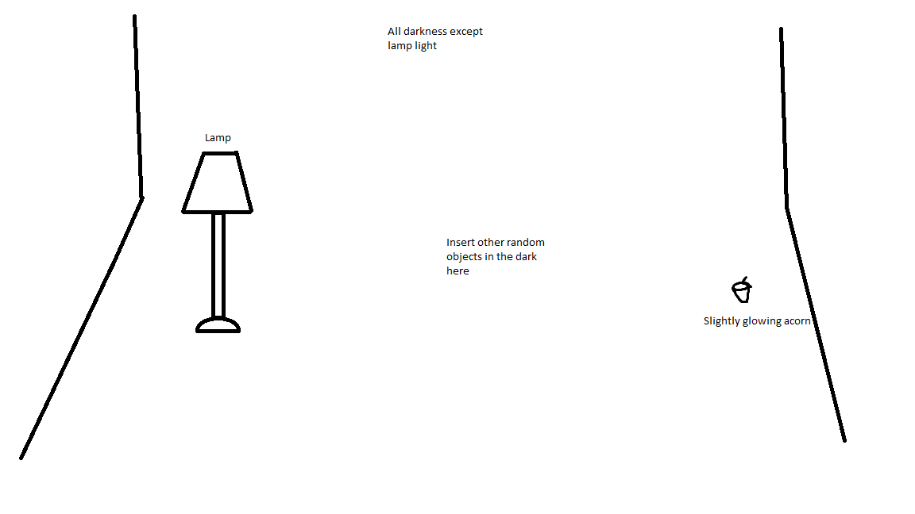
Some Level Designs
Notes:
I promise I do stuff too, I don’t want y’all to see all our secrets since I’m in charge of level design. Here they are anyway

